Slide 1
Introduction to ML (Machine Learning)
Abu Bakar Siddique Mahi

Slide 2
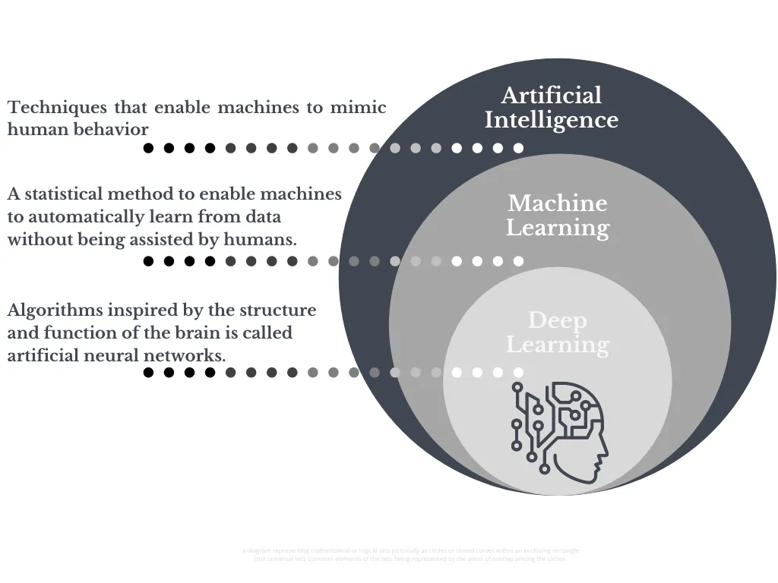
Deep learning is a subset of machine learning that uses artificial neural networks to mimic the learning process of the human brain.

Slide 3
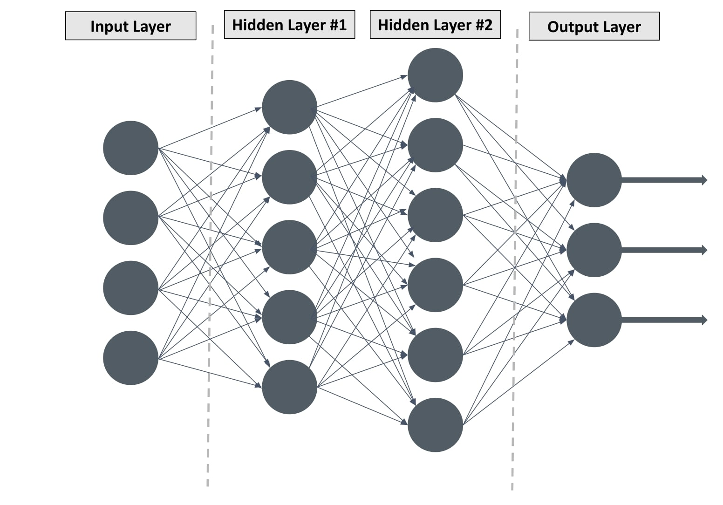
Artificial neural network

Slide 4
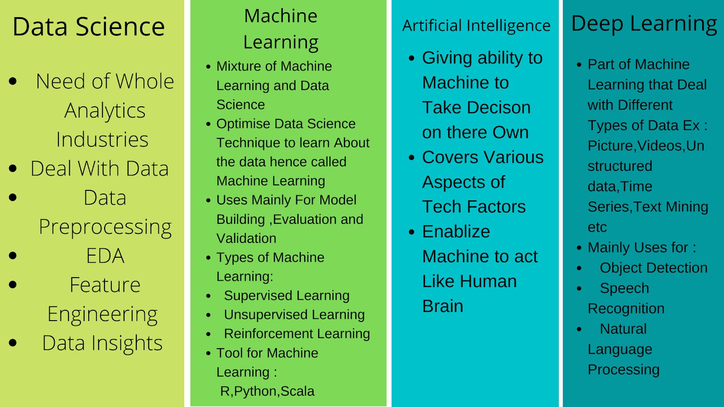

Slide 5
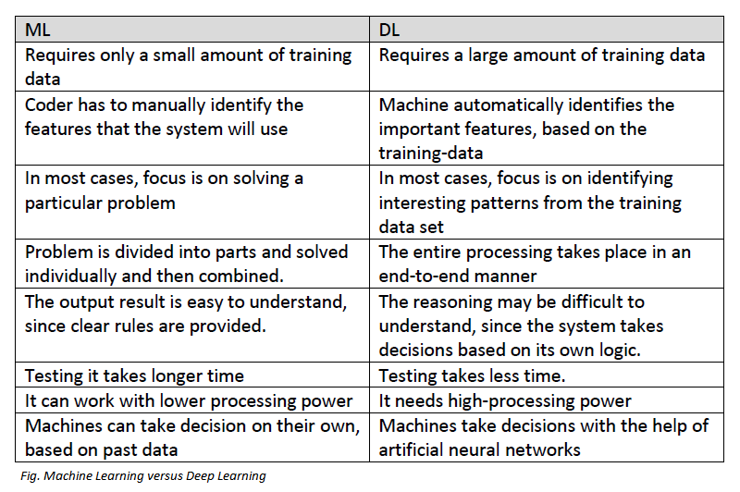

Slide 6
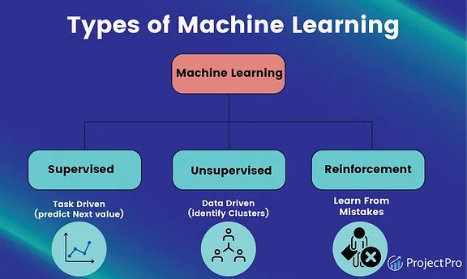

Slide 7
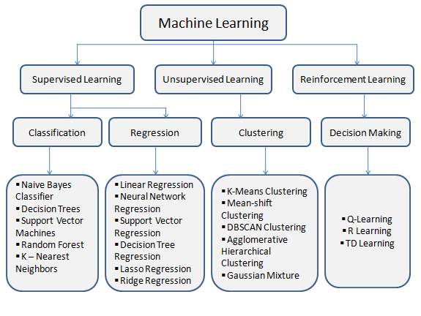

Slide 8
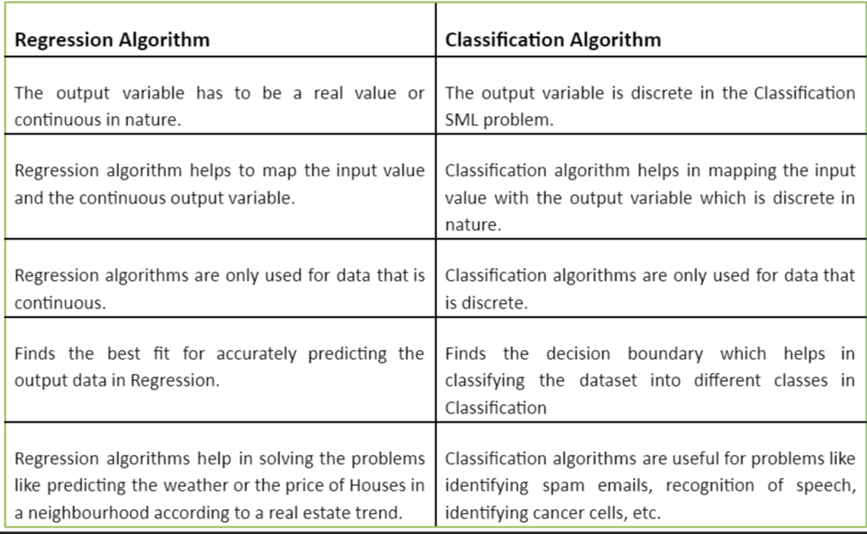

Slide 9
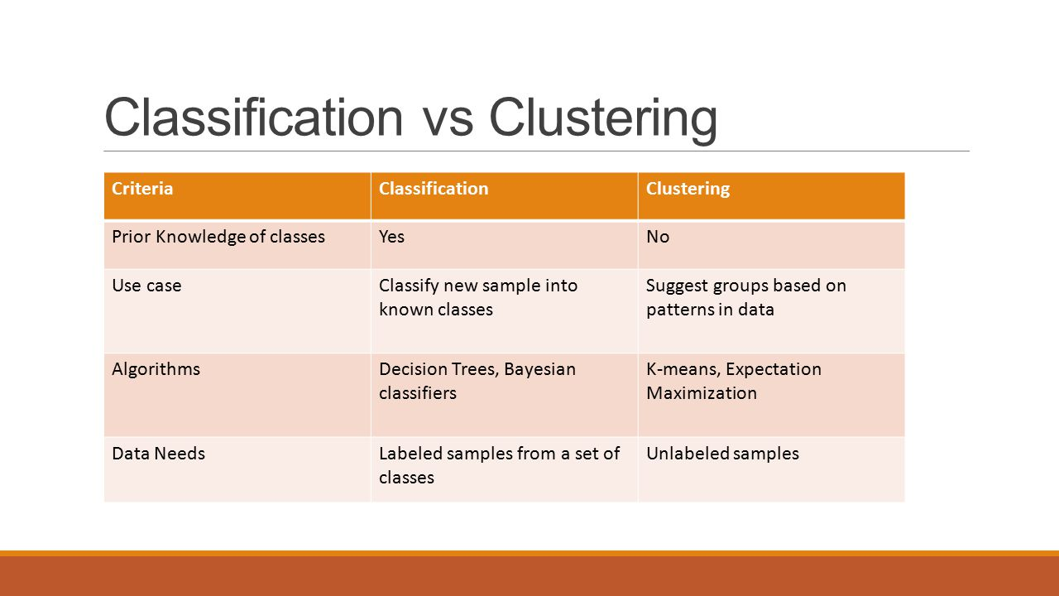

Slide 10
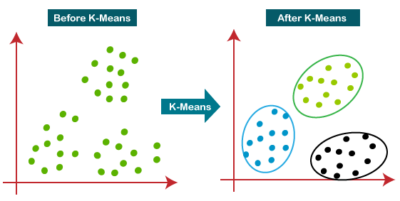

Slide 11
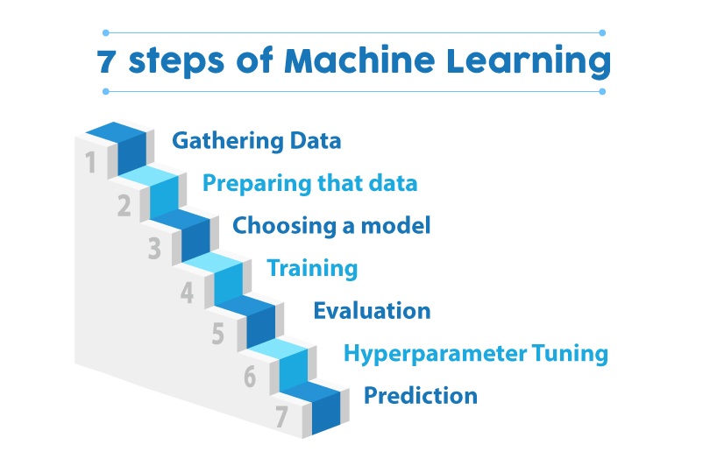

Slide 12
